Slide 1
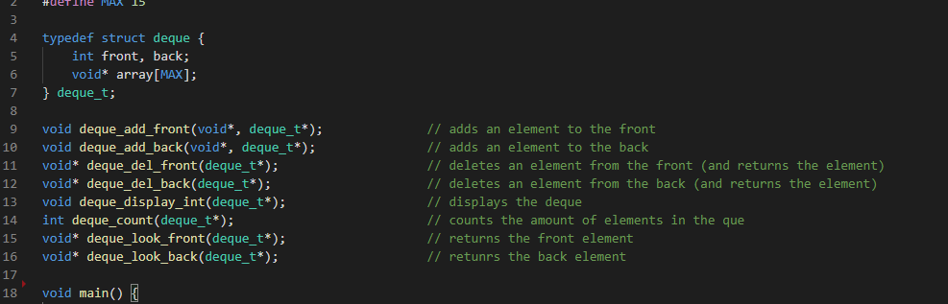

Data structures in C Double-ended-queue
A presentation by Marco Naumann
Image source: https://www.thoughtco.com/thmb/su46sbq08VX4unr8_ehrqKGreug=/2449x1224/filters:fill(auto,1)/Getty_cue_and_queue-158318139-5847493c3df78c0230e83369.jpg
Notes:
Img src: https://www.thoughtco.com/thmb/su46sbq08VX4unr8_ehrqKGreug=/2449x1224/filters:fill(auto,1)/Getty_cue_and_queue-158318139-5847493c3df78c0230e83369.jpg

Slide 2
Introduction
Content:
What is a double-ended-queue? – general
Array
Linked List
Blocks / Chunks
Just what is a deque?
Application
work stealing algorithm

Slide 3
What is a double-ended-queue?
General:
A sequential container which provides fast insertion and removal of data at both the beginning as well as the end of the data-structure.
Typical implementation:
Array
(Double-) Linked-List
Blocks / Chunks
Notes:
Die Datenstruktur deque ist am ehesten mit der Daten Struktur des Vector zu vergleichen
Mit welchem mitteln kann man dies tun (bsp, array, linked list, blocks / chunks,…)
Vor/nachteile
Was ist eine Double-Ended-Que
Was für Funktionen bringt Deque mit?
Was bringt eine deque eigentlich?

Slide 4
What is a double-ended-queue?
General : 1. Array:
Deque, build from an array…
For easy understanding… lets add some stuff:
deque_add_back – 1
deque_add_back – 2
deque_add_front – 3
deque_add_front – 4
0
1
2
4
3
0
1
2
3
4
5
6
7
8
9
?
Front Pointer
Back Pointer
Element
Notes:
NACH ALLOCATION DES ARRAYS!!!

Slide 5
What is a double-ended-queue?
General: 2. Linked-List
Deque build from a Double-Linked-List...
For easy understanding… lets add some stuff:
deque_add_back – 1
deque_add_back – 2
deque_add_front – 3
deque_add_front – 4
deque_del_back
4
3
0
1
2
?
Front Pointer
- Head
Back Pointer
-Tail
Element
Notes:
Ineffektiv… MALLOC

Slide 6
What is a double-ended-queue?
General: 3. Blocks/Chunks
Deque build from blocks/chunks...
head
blocks
headBl
tailBl
tail
head
blocks
tail
head
tail
ch0
e1
Notes:
Somit sind Blöcke direkt allokiert und man spart sich somit viele malloc befehle… zudem, die einzelnen Blöcke können sonst wo im Speicher liegen.
Man nehme, eine stuktur… eine karte… und chunks…
Okay… was brauchen wir dafür alles?
Wir wissen… head / tail
Dazu werfen wir ne Karte noch dazu um uns zu orientieren
Und… einen pointer IN der Karte auf das aktuelle ding…

Slide 7
What is a double-ended-queue?
Let's add some stuff here as well:
deque_add_back
… more… more… MUCH MORE!
Deque_add_front
… more… more… MUCH MORE!
General: 3. Blocks/Chunks
Deque build from blocks/chunks...
head
blocks
headBl
tailBl
tail
e6
e7
e8
ch2
ch0
ch1
ch0
ch1
ch0
e3
e1
e2
e4
e5
Notes:
Eingefügt, e2 und e3
Jetzt voll… darn it…
→ Was passiert, wenn ich jetzt hinten was neues anhänge?

Slide 8
Just what is a deque?
What functions does a deque provide?
Common name | My implementation | operation
push, cons | deque_add_front | Inserts element at the front
Inject, snoc, push | deque_add_back | Inserts element at the back
pop | deque_del_front | Removes first element and ret.
eject | deque_del_back | Removes last element and ret.
peek_front | deque_look_front | Returns the first element
peek_back | deque_look_back | Returns the last element

Slide 9
Just what is a deque?
What a deque provides:
Task | Linked List / Array / … | Deque
Access first element | O(1) | O(1)
Access last element | O(n) | O(1)
Arr(1)
Arr(2)
Arr(n)
Arr(99)
DATA
Notes:
Zugriffszeit…

Slide 10
Just what is a deque?
What a deque provides:
Task | Linked List / Array / … | Deque
Access first element | O(1) | O(1)
Access last element | O(n) | O(1)
Arr(1)
Arr(2)
Arr(n)
Arr(99)
DATA
DATA
Notes:
Zugriffszeit…

Slide 11


Application
Applications:
Web browser history
Saving from undo-actions in applications
Realistic queues
„work stealing algorithm“
!!!BACK!!!
Ah… nope… not today
Darn it, I am stuck here ☹
Notes:
Web-Browser verlauf
Aufgerufene Websites deque_add_front
Wenn die Liste „zu lang“ wird, werden Elemente einfach von hinten gelöscht

Slide 12
Application
Work Stealing Algorithm:
Job 3
Job 2
Job 2
Job 1
Job 1
Job 1
Thread 1
Thread 2
Thread n
Notes:
The randomized version of the work stealing algorithm presented by Blumofe and Leiserson maintains several threads of execution and schedules these onto P {\displaystyle P} processors. Each of the processors has a double-ended queue (deque) of threads. Call the ends of the deque "top" and "bottom".
Each processor that has a current thread to execute, executes the instructions in the thread one by one, until it encounters an instruction that causes one of four "special" behaviors:^{[2]:10}
A spawn instruction causes a new thread to be created. The current thread is placed at the bottom of the deque, and the processor starts executing the new thread.
A stalling instruction is one that temporarily halts execution of its thread. The processor pops a thread off the bottom of its deque and starts executing that thread. If its deque is empty, it starts work stealing, explained below.
An instruction may cause a thread to die. The behavior in this case is the same as for an instruction that stalls.
An instruction may enable another thread. The other thread is pushed onto the bottom of the deque, but the processor continues execution of its current thread.
Initially, a computation consists of a single thread and is assigned to some processor, while the other processors start off idle. Any processor that becomes idle starts the actual process of work stealing, which means the following:
it picks another processor uniformly at random;
if the other processor's deque is non-empty, it pops the top-most thread off the deque and starts executing that;
else, repeat.

Slide 13








tu-freiberg.de
TU Bergakademie Freiberg bergakademie_freiberg TUBergakademie TUBergakademie
TU BERGAKADEMIE FREIBERG Universitätskommunikation Prüferstr. 2 09599 Freiberg Tel. +49(0)3731 39-2711, -3461 kommunikation@tu-freiberg.de

Slide 14
Bye :D:
Quellen
Bildquelle: https://www.thoughtco.com/thmb/su46sbq08VX4unr8_ehrqKGreug=/2449x1224/filters:fill(auto,1)/Getty_cue_and_queue-158318139-5847493c3df78c0230e83369.jpg
Infoquellen:
https://bradfieldcs.com/algos/deques/introduction/
https://www.studytonight.com/data-structures/double-ended-queue
https://www.programiz.com/dsa/deque
https://www.cplusplus.com/reference/deque/deque/
https://en.wikipedia.org/wiki/Double-ended_queue
https://stackoverflow.com/questions/6292332/what-really-is-a-deque-in-stl/6292437
https://en.wikipedia.org/wiki/Work_stealing
https://actor-framework.readthedocs.io/en/latest/Scheduler.html
Notes:
The randomized version of the work stealing algorithm presented by Blumofe and Leiserson maintains several threads of execution and schedules these onto P {\displaystyle P} processors. Each of the processors has a double-ended queue (deque) of threads. Call the ends of the deque "top" and "bottom".
Each processor that has a current thread to execute, executes the instructions in the thread one by one, until it encounters an instruction that causes one of four "special" behaviors:^{[2]:10}
A spawn instruction causes a new thread to be created. The current thread is placed at the bottom of the deque, and the processor starts executing the new thread.
A stalling instruction is one that temporarily halts execution of its thread. The processor pops a thread off the bottom of its deque and starts executing that thread. If its deque is empty, it starts work stealing, explained below.
An instruction may cause a thread to die. The behavior in this case is the same as for an instruction that stalls.
An instruction may enable another thread. The other thread is pushed onto the bottom of the deque, but the processor continues execution of its current thread.
Initially, a computation consists of a single thread and is assigned to some processor, while the other processors start off idle. Any processor that becomes idle starts the actual process of work stealing, which means the following:
it picks another processor uniformly at random;
if the other processor's deque is non-empty, it pops the top-most thread off the deque and starts executing that;
else, repeat.

Slide 15
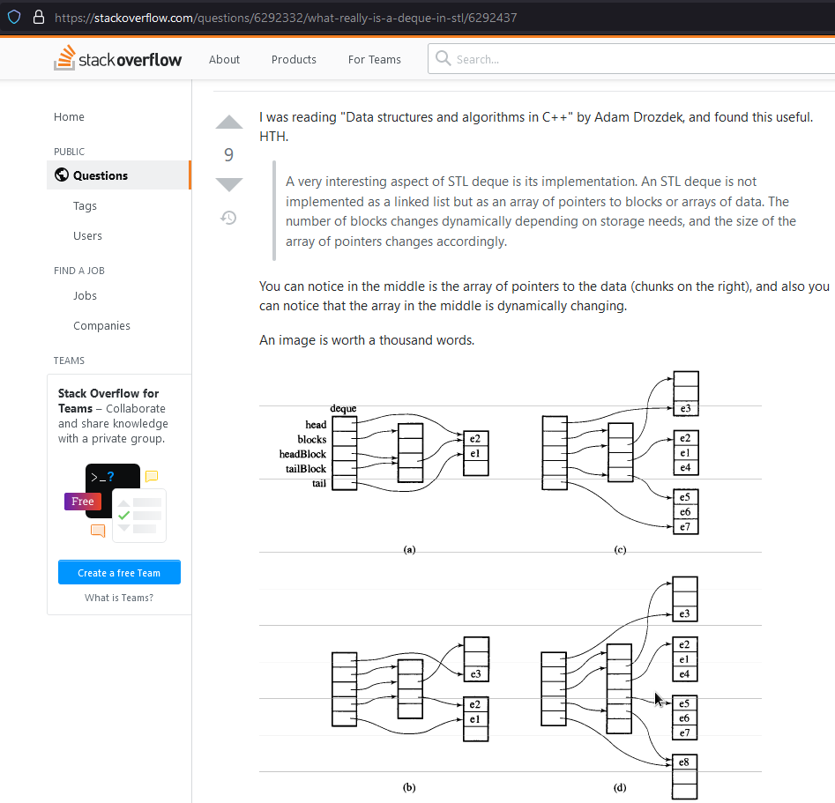
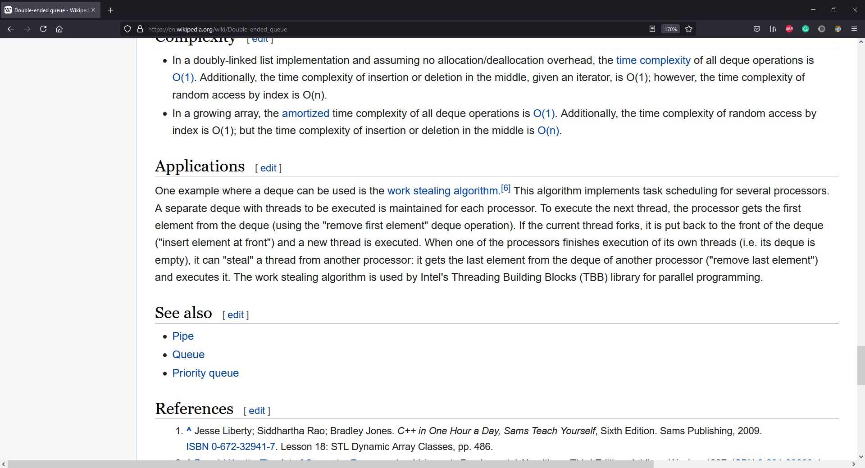
REEEEEEEE
REEEEEE
REEEEEEEEE
Blocks? –man kann das auch anders implementieren… ERWÄHNEN!
Benchmarking! VS Linked List
Meine implementierung VS die von python, oder c++
Wenn benchmark, mit –o3 benchmarken, ohne debug info
Deque in cpp… idee?!

